Slide 1

TRAINING CONTENT
Kubernetes Introduction
Session-1
Image Placeholder

Slide 2

Lecture Outline
What is Kubernetes?
Others Orchestration Tools
Container Runtime
Kubernetes Core Components
1
3
5
7
Docker Swarm vs Kubernetes
Why Kubernetes?
Kubernetes Architecture
Installation of Kubernetes Cluster
2
4
6

Slide 3
What is Kubernetes
Kubernetes is an open-source container orchestration tool.
Developed by Google
Container Deployment platform
Managed Containerized applications

Slide 4
Docker Swarm vs Kubernetes
Docker Swarm and Kubernetes are both container orchestration platforms
But they have different features and capabilities.
Docker Swarm is the native container orchestration solution provided by Docker.
It is lightweight.
Within the Docker containers, Docker Swarm provides automated load balancing.
A simpler architecture compared to Kubernetes.
Docker Swarm provides a straightforward and easy-to-use interface.
It offers features like service discovery, load balancing, rolling updates, and high availability.
Swarm focuses on simplicity and ease of use.
Docker Swarm is generally considered easier to learn and use compared to Kubernetes.
Docker Swarm is strongly tied to the Docker API, which limits its functionality as compared to Kubernetes.
Customization options and extensions are limited in Docker Swarm.

Slide 5
Docker Swarm vs Kubernetes
Docker Swarm and Kubernetes are both container orchestration platforms, but they have different features and capabilities.
Kubernetes has a more complex architecture, with a master node and worker nodes.
Kubernetes is designed to scale to large clusters with thousands of nodes.
Kubernetes offers a wide range of features, making it more suitable for complex and production-grade deployments.
It provides advanced networking, service discovery, load balancing, auto-scaling, and fine-grained configuration options.
Kubernetes also supports stateful applications and offers features like persistent storage, secret management, and extensive health monitoring.
Kubernetes has a steeper learning curve due to its more complex architecture and extensive feature set.

Slide 6
Others Orchestration Tools
Kubernetes
Docker Swarm
Apache Mesos
Nomad
Amazon ECS (Elastic Container Service)
Google Kubernetes Engine (GKE)
Microsoft Azure Kubernetes Service (AKS)
Rancher
OpenShift

Slide 7

Why Kubernetes?
01
01
Security
07
02
07
Micro-services compactivity
02
Productivity
06
Stateful Application
06
03
03
Scalability
05
Replicated Application
04
Wide Ecosystem
05
04

Slide 8
Container Runtime
Docker
Containerd
CRI-O
rkt (pronounced "rocket")
LXC/LXD: LXC (Linux Containers) and LXD (pronounced "lex-dee")
Kata Containers
gVisor

Slide 9
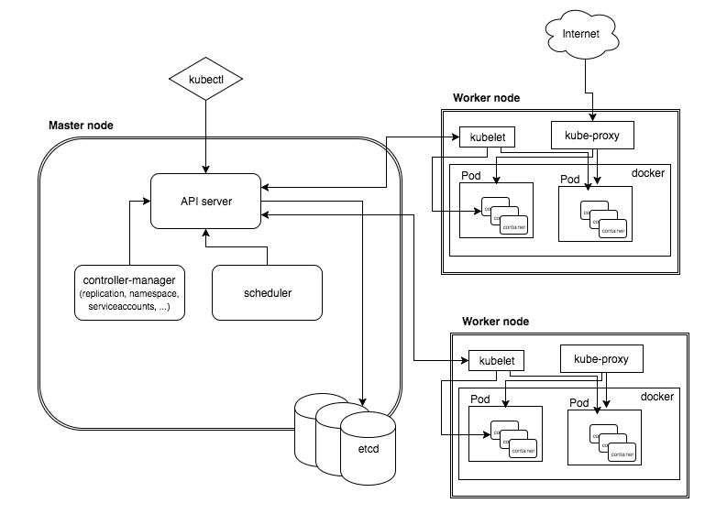
Kubernetes Architecture

Slide 10
Kubernetes Core Components
Control Plan Components:
Kube-api server
ETCD
Kube-Scheduler
Kube-Controller-Manager
Note: All Control Plan Component resides on Master Node and Deployed as a static pod (Deployed during cluster bootstrapping)

Slide 11
Kubernetes Core Components
Worker node components:
Kubelet
Kube-proxy
Container runtime

Slide 12
Installation of Kubernetes Cluster
Pre-requisites
At least two VMs(one for master and other for wroker)
A non-root user with root/administrator privileges.
Setting Up Systems
Setup correct /etc/hosts file
Setup Firewalld
Setup SELinux
Enable kernel Modules
Disable SWAP

Slide 13
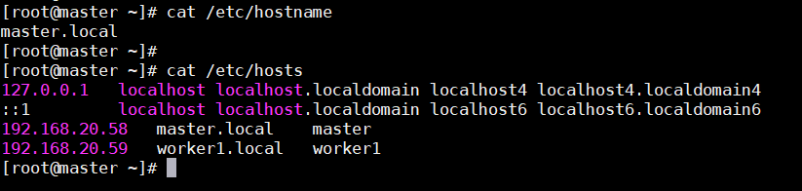
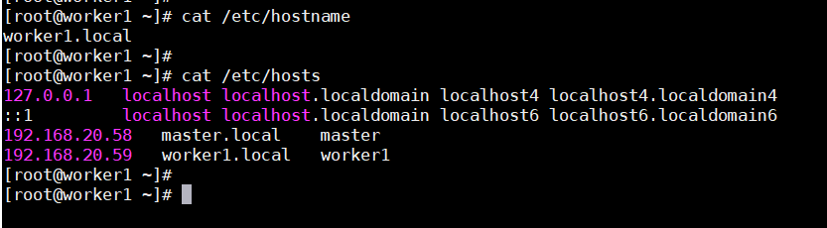
Installation of Kubernetes Cluster
Set hostname and hosts file like in master
Set hostname and hosts file like in Worker

Slide 14
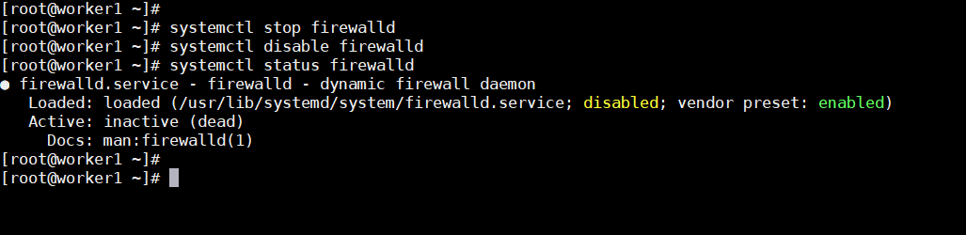
Installation of Kubernetes Cluster
Disable System Firewall

Slide 15
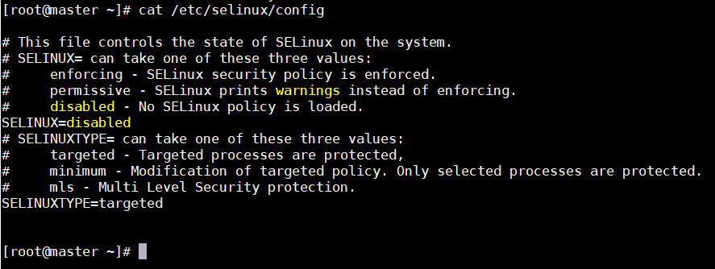
Installation of Kubernetes Cluster
Disable SE Linux

Slide 16
Installation of Kubernetes Cluster
Enable Kernel modules
Run the following command to enable the kernel modules "overlay" and "br_netfilter".
sudo modprobe overlay sudo modprobe br_netfilter
To make it permanent, create the configuration file to "/etc/modules-load.d/k8s.conf"
cat <<EOF | sudo tee /etc/modules-load.d/k8s.conf overlay br_netfilter EOF

Slide 17
Installation of Kubernetes Cluster
Next, create the systemctl params required using the following command.
cat <<EOF | sudo tee /etc/sysctl.d/k8s.conf net.bridge.bridge-nf-call-iptables = 1 net.bridge.bridge-nf-call-ip6tables = 1 net.ipv4.ip_forward = 1 EOF
To apply the new sysctl configuration without reboot, use the following command. You should get the list of default sysctl params on your system and be sure you get sysctl params that you just added in the file "k8s.conf".
sudo sysctl --system

Slide 18
Installation of Kubernetes Cluster
Disable Swap
To disable SWAP, you will need to comment on the SWAP configuration on the "/etc/fstab" file. This can be done by using the single command via sed (stream editor) or manually editing the /etc/fstab file.
sudo sed -i '/ swap / s/^\(.*\)$/#\1/g' /etc/fstab
Now turn off the SWAP on the current session using the below command. Then, verify the SWAP is off using the "free -m" command. You should see the SWAP has "0" values, which means it's now disabled.
sudo swapoff -a free -m

Slide 19
Installation of Kubernetes Cluster
Installing Container Runtime: Containerd
01
Before adding the repository, run the DNF command below to install additional tools "dnf-utils".
sudo dnf install dnf-utils
Now run the following command to add the Docker repository for CentOS-based systems.
02
sudo yum-config-manager \ --add-repo \ https://download.docker.com/linux/centos/docker-ce.repo
03
Run the following command to check and verify repositories on your Linux systems.
sudo dnf repolist sudo dnf makecache

Slide 20
Installation of Kubernetes Cluster
Next, install the containerd package using the DNF command below.
04
sudo dnf install containerd.io
After installation is finished, run the following command to back up the default containerd configuration and generate a new containerd config file.
05
sudo mv /etc/containerd/config.toml /etc/containerd/config.toml.orig sudo containerd config default > /etc/containerd/config.toml
Now modify the containerd config file "/etc/containerd/config.toml" using the following command.
06
sudo nano /etc/containerd/config.toml

Slide 21
Installation of Kubernetes Cluster
07
Change the value of cgroup driver "SystemdCgroup = false" to "SystemdCgroup = true". This will enable the systemd cgroup driver for the containerd container runtime.
[plugins."io.containerd.grpc.v1.cri".containerd.runtimes.runc] ... [plugins."io.containerd.grpc.v1.cri".containerd.runtimes.runc.options] SystemdCgroup = true
Next, run the following systemctl command to start and enable the containerd service. This will add the containerd service to be run automatically at system boot.
08
sudo systemctl enable --now containerd

Slide 22
Installation of Kubernetes Cluster
Lastly, check and verify the containerd service using the below command. You should see the containerd is enabled and will be run automatically at system boot. And the current status of containerd service is running.
09
sudo systemctl is-enabled containerd sudo systemctl status containerd

Slide 23
Installation of Kubernetes Cluster
Installing Kubernetes Packages
01
Run the following command to add the Kubernetes repository for RHEL/CentOS-based operating systems.
cat <<EOF | sudo tee /etc/yum.repos.d/kubernetes.repo [kubernetes] name=Kubernetes baseurl=https://packages.cloud.google.com/yum/repos/kubernetes-el7-\$basearch enabled=1 gpgcheck=1 gpgkey=https://packages.cloud.google.com/yum/doc/yum-key.gpg https://packages.cloud.google.com/yum/doc/rpm-package-key.gpg exclude=kubelet kubeadm kubectl EOF

Slide 24
Installation of Kubernetes Cluster
Now check the list of repositories and generate a new metadata cache using the dnf command below. And you should see the Kubernetes repository is added to Rocky Linux systems.
02
sudo dnf repolist sudo dnf makecache
Next, install Kubernetes packages using the following dnf command. Input Y to confirm the installation and press ENTER to continue, and the installation will begin.
03
sudo dnf install kubelet kubeadm kubectl --disableexcludes=kubernetes

Slide 25

Installation of Kubernetes Cluster
After installation is finished, run the following systemctl command to start and enable the kubelet service.
Then, check the kubelet service and make sure it's enabled and running on all nodes.
This service is the main Kubernetes service that will wait for any events when you initialize the cluster or join the node to the cluster.
sudo systemctl enable --now kubelet

Slide 26
Installation of Kubernetes Cluster
Initializing Kubernetes Control Plane
01
Before initializing the Control Plane node, run the following command to check the "br_netfilter" kernel modules are enabled. If you get an output from the command, it means the "br_netfilter" module is enabled.
lsmod | grep br_netfilter

Slide 27
Installation of Kubernetes Cluster
02
Next, run the following command to download images that are required for the Kubernetes Cluster.
sudo kubeadm config images pull
After the download is finished, run the following "kubeadm init" command to initialize the Kubernetes Cluster on the "master" server. This node "master" will automatically be selected as the Kubernetes Control Plane because this is the first time initializing the cluster.
03
sudo kubeadm config kubeadm init --control-plane-endpoint=192.168.20.58 --pod-network-cidr=10.10.0.0/16 --cri-socket=unix:///run/containerd/containerd.sock
pull

Slide 28
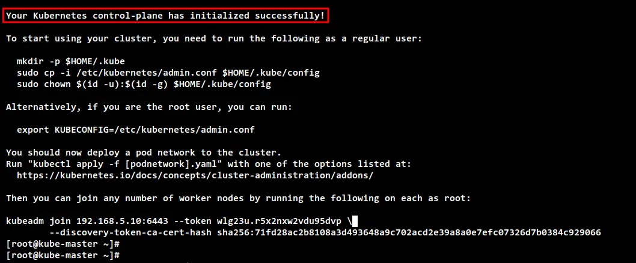
Installation of Kubernetes Cluster
When the initialize is finished, you can see the message such as "Your Kubernetes control-plane has initialized successfully!" with some important output messages for setting up the Kubernetes credentials and deploying the Pod network add-on, the how to add the worker node to your Kubernetes Cluster.

Slide 29
Installation of Kubernetes Cluster
Before you start using the Kubernetes Cluster, you will need to set up the Kubernetes credentials. Run the following command to set up the Kubernetes credentials.
mkdir -p $HOME/.kube cp -i /etc/kubernetes/admin.conf $HOME/.kube/config sudo chown $(id -u):$(id -g) $HOME/.kube/config
Now you can use the "kubectl" command to interact with your Kubernetes cluster. Run the following "kubectl" command to check the Kubernetes Cluster information. And you should see the Kubernetes control plane and the coredns running.
kubectl cluster-info

Slide 30

Installation of Kubernetes Cluster
Installing CNI Plugin:Calico
#wget https://raw.githubusercontent.com/projectcalico/calico/master/manifests/calico.yaml
#kubectl apply -f calico.yaml
Check the list of running pods on your Kubernetes using the following command. if your Kubernetes installation is successful, you should see all main pods for Kubernetes which includes Flannel pods are running.
kubectl get pods --all-namespaces

Slide 31
Installation of Kubernetes Cluster
Adding Worker Nodes to Kubernetes
After initializing the Kubernetes Control Plane on the "k8s-master" server, you will add worker nodes "worker1"
kubectl get nodes -o kubeadm join 192.168.20.58:6443 --token 4b9r0n.d8obxe0kwthzomgk \
--discovery-token-ca-cert-hash sha256:6024e5f28537a1464bf93334e7bd018e72906733e93e400f99639667a0d4bf9b
Lastly, check and verify all available nodes on the Kubernetes Cluster using the 'kubectl" command below. You should see the ‘master" server is running as the Kubernetes Control Plane, and the "worker1“servers are running as the worker node.
kubectl get nodes -o wide

Slide 32
References
https://www.howtoforge.com/how-to-setup-kubernetes-cluster-with-kubeadm-on-rocky-linux/
https://raw.githubusercontent.com/projectcalico/calico/master/manifests/calico.yaml

Slide 33
Thank You
Image Placeholder

